Slide 1

Cryptography and Security Office
Sharif Technology Services Complex
Number 407

Slide 2

Honeypots on NB-IoT
Information Systems Security Lab Plus
ISSL+
Office

Slide 3
+
I
S
S
L
Contents
01
Introduction to Honeypot
Definition, History, Preliminaries
Why do we need it; purpose of honeypots
Actions; different use of honeypots
Sharif Technology
Services Complex Office
02
Classification
Different classifications based on features
03
Implementation of Honeypots
Tools
Examples of honeypots
04
Special on NB-IoT
Why IoT is so important
Current procedures
Special features of NB-IoT
05
Conclusion

Slide 4
Our Team
Pouria Dadkhah
Dr. Siavash Ahmadi
Tony Wilson
Ms Student
Manager
Designer
Pouria.dadkhah@gmail.com
s.Ahmadi@sharif.edu
abcd@company.com
Facebook.com/abcd
Twiter.com/abcd

Slide 5

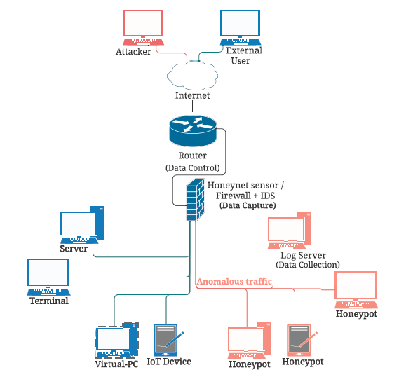
What is Honeypot
A honeypot is a tool that serves as a decoy to attract attackers and deceive them into thinking that they have gained access to a real system.
Honeynet

Slide 6
Brief History of Honeypot
1985
2000
2015
Military lures using fake reports
Spitzner coins term Honeyd project
Minn high interaction IoT honeypot
Cheswick observes cracker
Kippo Project
1990
2010

Slide 7
Use of Honeypot
Total Aim
Increase the target security.
Distract and Decive
Warning to owner
Implement a fake system and guide attackers to them instead of main one.
Keep Log of different connections and keep attention to malicious requests and avoid them to main core.
Examine the Users
Have an active connection with users than just waiting for connection. More on client honeypots.
Gain New Information
Honeynets
Analyze the attacker behavior and learn about new threats to improve device security.
Build a network of honeypots to make your whole network stronger. Each honeypot can support its own required features.

Slide 8

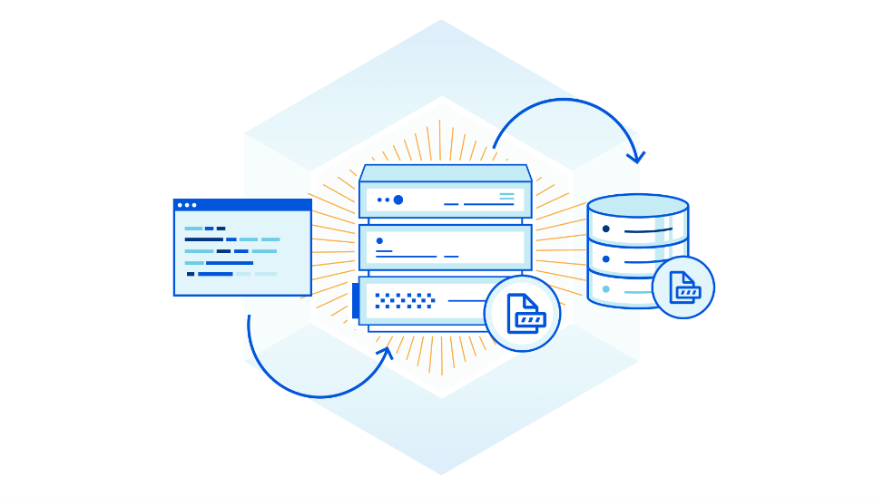
Honeypot Algorithms
Intruders
Ban User
Keep Log
Network Based Attack
disclosure
Threat & Actions
Collect Info
Active connection
General Threeats

Slide 9
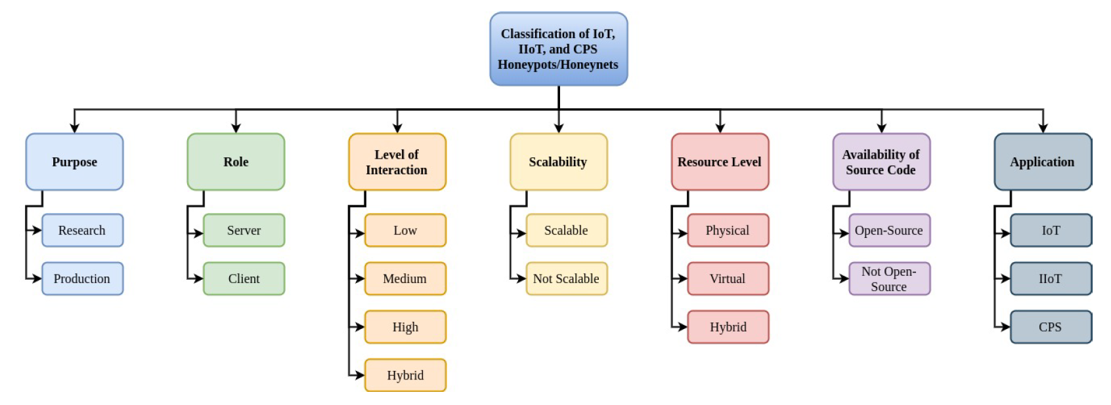
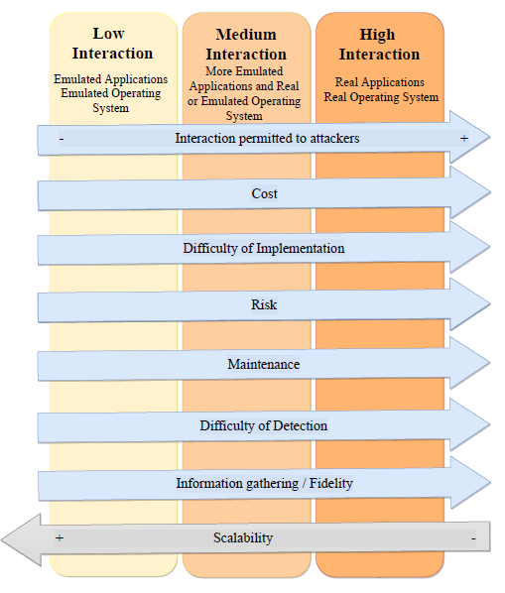
Honeypot
Classifications
Different Types of Classification

Slide 10




Implementation of Honeypots;
Tools
Researchers use different types of tools to help them implement and develop their specific honeypots and satisfy their needs.
Shodan is a search engine for Internet-connected devices, which includes everything from web cams, to medical devices. it indexes everything that is somehow connected to the Internet, their location, and their users, providing valuable information about the vulnerabilities of today’s interconnected world.
Nmap is an open-source, free tool for exploring networks and security auditing. It works by sending packets and then analyzing the responses. It is especially used by network administrators, auditors, and hackers to scan and determine what hosts are available on a network, the services they are offering, their operating systems, and other valuable information.
One of the most important aspects of honeypots is to hide their fingerprints from attackers
They should communicate appropriately based on user requests. To do so, one of the best
Tools is ML and DL algorithms.
Virus Total is an online service that analyzes suspicious files and URLs to detect types of malware and malicious content using antivirus engines and website scanners. It provides an API that allows users to access the information generated by VirusTotal.

Slide 11
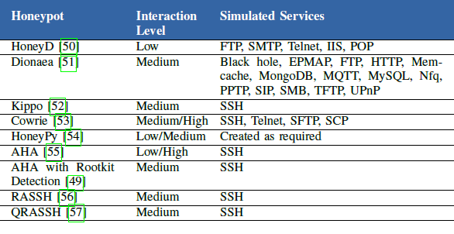
Implementation of Honeypots;
General Honeypot Examples
There are various general application honeypots that have an inheritance relationship with later research and honeypots for IoT applications. In other words, while these honeypots and honeynets were not specifically created for IoT, they are being used in research for IoT honeypots and honeynets.

Slide 12

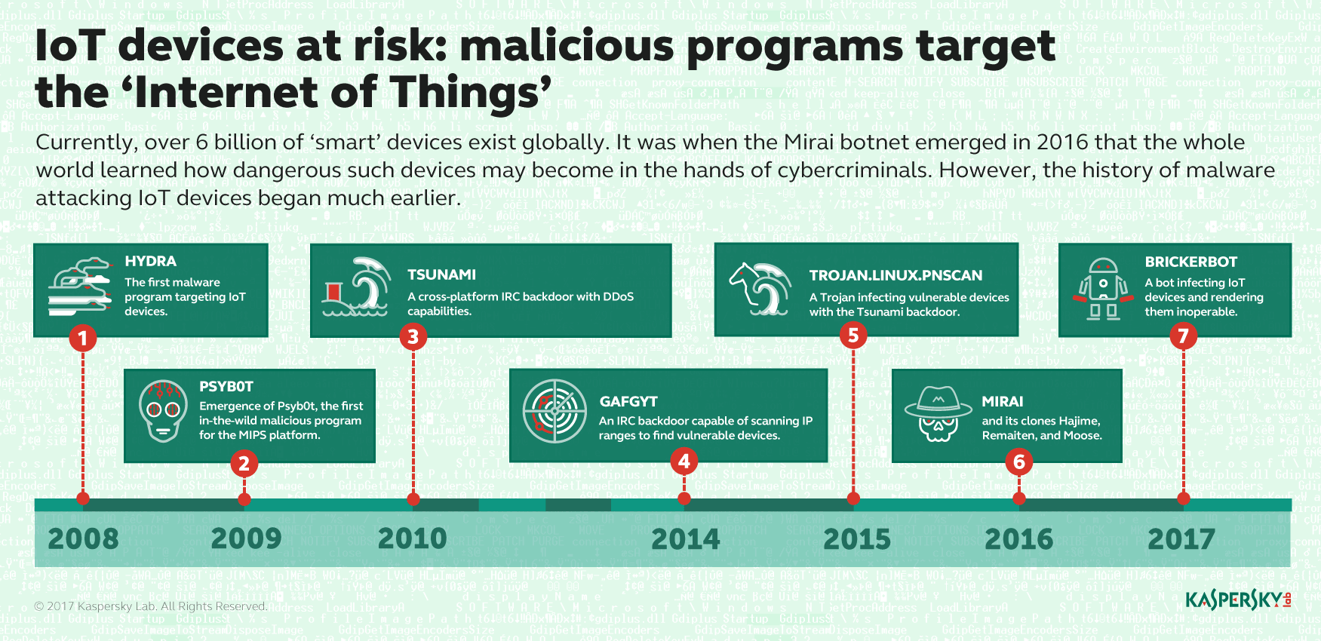
IoT Honeypots
01
Frequent Use
As we see the usage of IoT devices and it’s application has been rapidly growth these years that forces us to pay more attention on it’s security.
02
Weak Security
Every IoT platform has its optimizations due to it’s limitations. So the security will be sacrificed in some aspects.
03
Variety of Targets
In addition to number of IoT devices, the use and end devices can be so important that needs special attention than normal IoT devices like government uses.

Slide 13
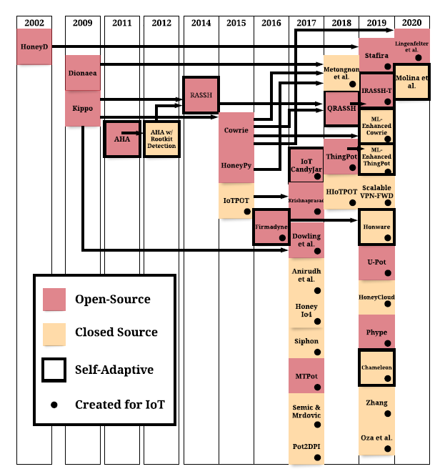
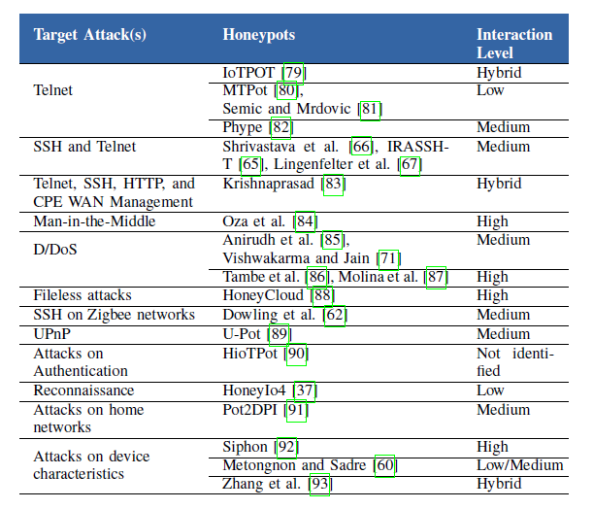
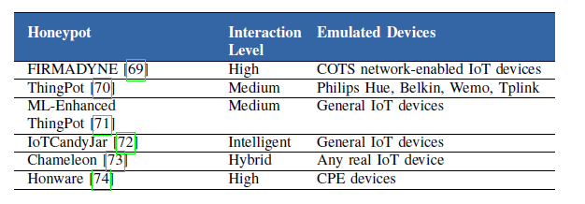
IoT Honeypots
Current works & Examples
Different Clustering
Inheritances
Customize Implementations
Based on Attack
Fully Emulation

Slide 14
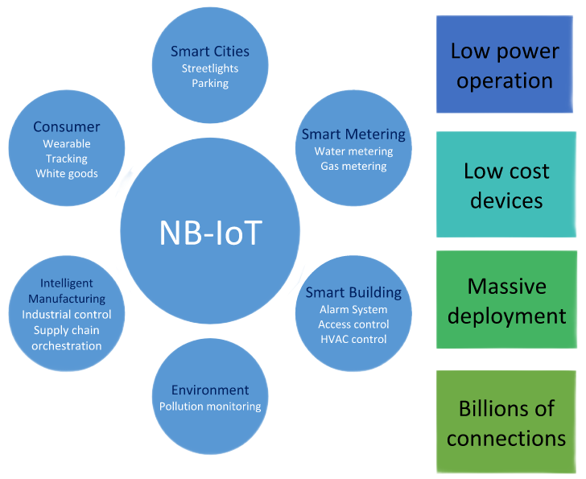
NB-IoT
Narrowband Internet of things (NB-IoT) is a low-power wide-area network (LPWAN) radio technology standard developed by 3GPP for cellular devices and services.
Why does it need honeypot?
NB-IoT devices also need to be protected by Honeypot for the previously mentioned reasons (general and Internet of Things). Also, due to their special features and protocol and their limitations, they also have special reasons for implementing their own honeypot, which we will explain in more detail in the next slide.

Slide 15
NB-IoT Honeypots
Vulnerabilities
&
Security Threats
Scan using malicious UE
Signal intelligence and traffic analysis
Jamming
Security keys
Threats on physical security

Slide 16

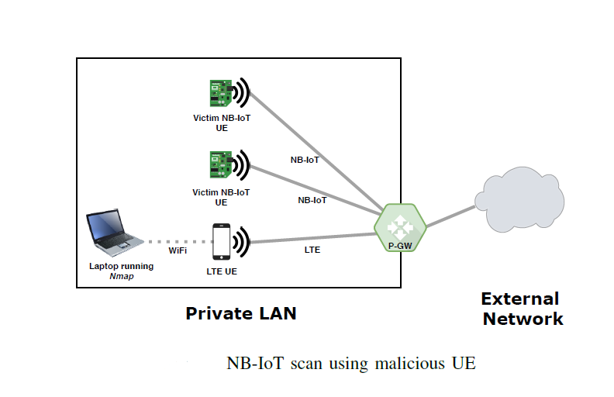
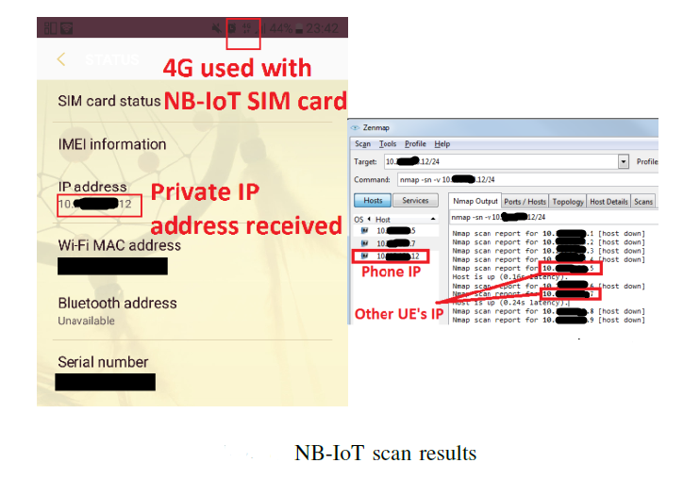
A Sample Use; More Details
As UEs can send IP data, classical attacking techniques over IP (e.g. port scanning, ARP spoofing, DNS spoofing) may be possible inside the NBIoT network as well.
• set up a Packet
• Data Protocol context by APN
Connect PGW
Tools such az zenmap
• Example 1. if the victim’s UE opens a port to communicate with an IoT Server, the attacker using a malicious UE could send malicious data to the open port, masquerading as the IoT Server
• Example 2. Another impact this attack could have is DoS by battery exhaustion
Scan Attack using malicious UE
A network diagram of the setup example

Slide 17

Application Protocols
CoAP
MQTT
VISION
MISSION
CoAP functions as a sort of HTTP for restricted devices, enabling equipment such as sensors or actuators to communicate on the IoT. The protocol is designed for reliability in low bandwidth and high congestion through its low power consumption and low network overhead. In a network with a lot of congestion or limited connectivity, CoAP can continue to work where TCP-based protocols such as MQTT fail to exchange information and communicate effectively.
a lightweight protocol that is widely used by IoT devices to communicate with their brokers/servers situated on remote locations and clouds. The protocol is simple and consumes much less bandwidth and power than its peers, making it best for devices where network bandwidth and power are constrained.
Security Attacks
Common Attacks
Parsing attacks
Caching attacks by proxy
The amplification attacks
Spoofing attacks
Access Control List
ACL and Authentication
Broker-Bridge Configuration
Gaining MQTT Credentials
Achieving Remote Code Execution
Information-Disclosure Bugs

Slide 18
Conclusion
Honeypots are complementary security devices beside main protections like firewalls and IDS which act as a decoy to attract attackers and malicious activities to protect main device from disclosure and network based attacks.
NB-IoT on the other hand is a popular and useful cellular based platform that because of its low power feature lacks of important security options such as that would be so crucial in special applications.
So far there has been variety of good works on honeypots for IoT systems but not NB-IoT and there are plenty of work that can be done in this area based on open source current honeypots by improving and customizing protocols that suits our application and needs to face new attacks and threats on NB-IoT platforms.
At the end it should be considered that besides of plenty of advantages of honeypots, its so important to implement them correctly because based on the nature of these devices it can become a threat to device and lead attacker to important part of main system.

Slide 19
References
A Survey of Honeypots and Honeynets for Internet of Things, Industrial Internet of Things, and Cyber-Physical Systems; bearXiv: 2108.02287v1 [cs.CR] 4 Aug 2021
IoT Honeypot: A Review from Researcher’s Perspective; Mohamad Faiz Razali, 2018 IEEE Conference on Applications, Information and Network Security (AINS)
Honeypots Mathias Gibbens Harsha vardhan Rajendran
Security issues in internet of things: Vulnerability analysis of LoRaWAN, sigfox and NB-IoT; 2019 Proceedings of 3rd Global IoT Summit
Honeypots for Internet of Things Research: An Eective Mitigation Tool Shen Xin En1 Liu Si Ling1 Fan Cheng Hao1 1Technische Universitat Munchen Asia 2021
An Overview of Security in CoAP: Attack and Analysis . 2019 5th International Conference on Advanced Computing & Communication Systems (ICACCS)
https://www.cse.wustl.edu/~jain/cse571-09/ftp/honey/ ; A Practical Guide to Honeypots
https://www.hindawi.com/journals/scn/2019/2627608/ ; Automatic Identification of Honeypot Server Using Machine Learning Techniques
https://threatpost.com/critical-mqtt-bugs-industrial-rce-moxa/178399/#:~:text=Gaining%20MQTT%20Credentials,on%20the%20target%20operating%20system ;
Critical MQTT-Related Bugs Open Industrial Networks to RCE Via Moxa

Slide 20
I
S
S
Thank You
Sharif Technology
Services Complex Office
L
+
Cryptography and Security Office

